Slide 1
Basic Illumination Models
Presented By: Prasamsha Nepal

Slide 2
Introduction
What is illumination???
It is the amount of light that falls on a surface.
Definition: A model that describes how light interacts with a surface.
Purpose: Used to calculate light intensity at a point on an object.
Factors Influencing Illumination:
Optical properties of the surface
Background lighting conditions
Light source specifications

Slide 3
Types of Illumination Models
Ambient Light
Diffuse Reflection
Specular Reflection

Slide 4

Ambient Light
Definition: Light that is uniformly present in a scene, even without a direct light source.
Sources: Natural light (sunlight, windows) or artificial light (room lights).
Properties:
Equal intensity across the scene
No specific direction
Affects all objects equally
Equation:
Where,
I =intensity
Ka =Ambient reflection coefficient
Ia = Ambient light intensity

Slide 5
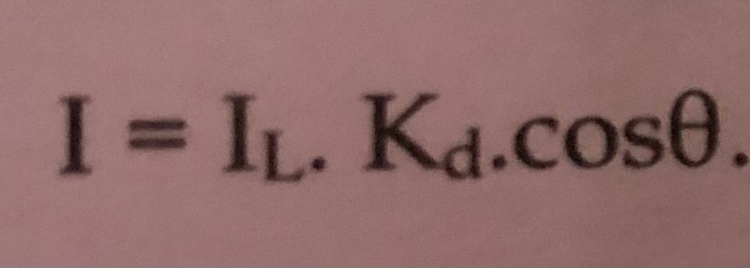
Diffuse Reflection
Definition: Uniform illumination across a surface due to scattered light reflections.
Example: Light bouncing off walls, floors, and ceilings.
Properties:
Reflection is independent of viewing direction.
Follows Lambert’s Cosine Law:
IL​ = Light intensity
Kd​ = Diffuse reflection coefficient
θ = Angle between light direction and surface normal

Slide 6
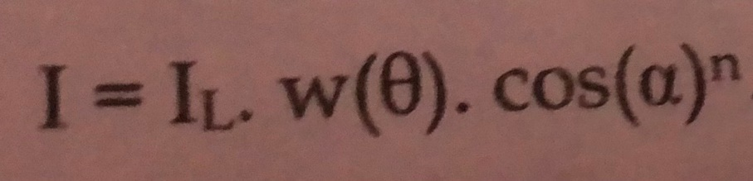
Specular Reflection
Definition: Bright highlights on smooth, shiny surfaces due to concentrated light reflection.
Examples: Polished metal, glossy paint, oily skin.
Properties:
Depends on light direction, surface normal, and viewer position.
Follows the Specular Reflection Model:
IL​ = Light intensity
w(θ) = Fraction of directly reflected light
α = Specular reflection exponent
Higher n → sharper reflection (mirror-like)

Slide 7
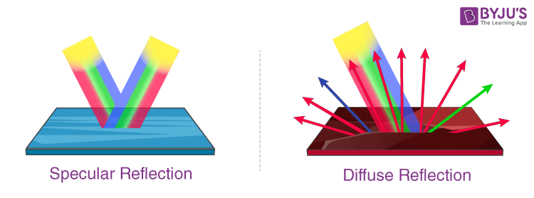

Slide 8
Conclusion
Illumination models help understand how light interacts with surfaces.
Three types:
Ambient Light → Background light, uniform illumination.
Diffuse Reflection → Scattered light, matte surfaces.
Specular Reflection → Shiny highlights, mirror-like reflection.

Slide 9
Thankyou ^_^

